Slide 1
5G-DoS Attacks
GAndrei

Slide 2
What is a DoS attack?
DoS stands for “denial of service”. A DoS attack is a cyber-attack that has the purpose of making a machine’s or a network’s resources and features unavailable to its users.
The main method of this attack is sending what might be called a “flood”, which is a large number of requests which only have the aim of either overloading the machine or network or downright to make it unavailable

Slide 3
The more devices, the more entry points
The more devices there are, the higher the chances that X number of devices is going to be infected by a botnet. Botnets are self-propagating malware that infects devices and basically links them to a centralized server. The attacker uses the network to ramp up the DoS attack, having a large number of devices which allows him to send even more requests during a certain timeframe. Since the IoT is ever growing, so is the possible attackers number. To go further, the increased bandwidth of 5G networks is most likely going to ensure that botnets aren’t going to need so many “zombies” in order to actually cripple a target.

Slide 4
Example of a peculiarity of a DoS attack on a 5G network
The 3GPP has a feature called overload control indicator. Due to the necessity of network functions having to communicate with each other, there must be a method of making sure they don’t overload.
This indicator comes as a header that can be put in any message. The sender basically informs the receiver he shouldn’t be disturbed. The problem behind this is the fact that there is no checking of the information in the header to match the senders identity.

Slide 5
Example of a DoS attack on a 5G network
This in turn allows others to basically leave the one whose identity gets used with no communication with the NF for the duration of the “do not disturb” request. While the do not disturb is in place, the network would use cached data instead of communicating. This circumstance could be a perfect one for launching an attack, due to the cover that’s being given by the sent request. It would make almost sure that there are no real-time updates or data syncronisation.

Slide 6
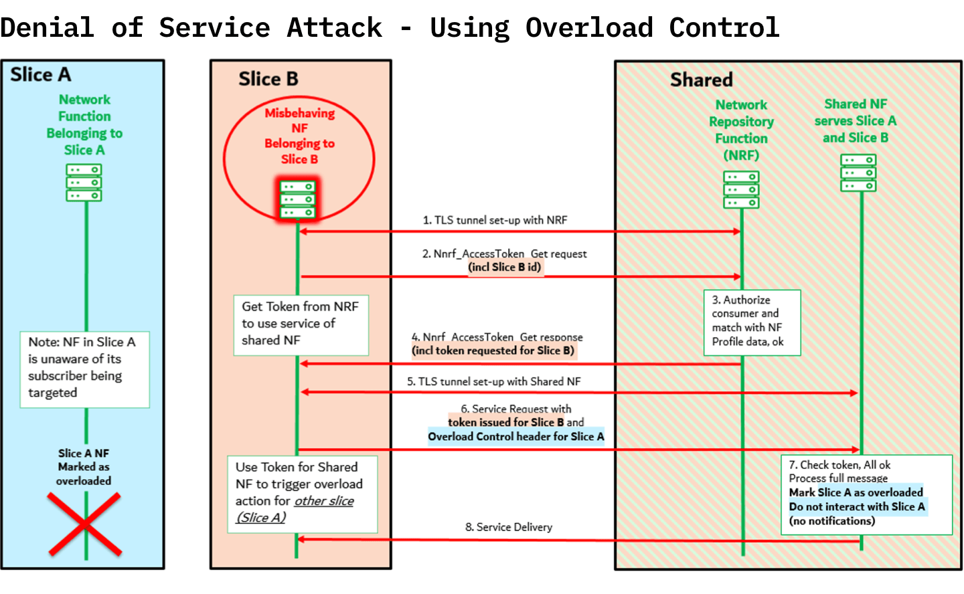
Example of OCI/OCH

Slide 7
A potential way of countering DDoS attacks
According to a relatively recent test-study, the mechanism referred to as “IPSVM” which stands for Intrusion Prevention System’s virtual machines, might be a decent way of protection. This mechanism is deployed in a dynamic way, according to the amount of traffic or load. Some additional rules of deployment might be key when it comes down to covering most DDoS attacks. To evaluate them at an actual level, the test was conducted in a 5G NFV environment which was built with 5G NFV environment tools. According to some information sources , despite this being the first experiment ran in a 5G NFV environment, this one has a very good chance of stopping DDoS attacks.

Slide 8
Conclusion
While the 5G brings out the potential of devices, it also enables potential hackers to leverage them easier, for example making volumetric attacks(which aim to deplete a network’s bandwidth) way easier to accomplish with a lesser number of zombies due to the low-latency high bandwidth 5G provides.

Slide 9
References
https://www.allot.com/blog/ddos-attacks-5g-everything-need-know/
https://www.techtarget.com/searchsecurity/feature/DDoS-attacks-among-top-5G-security-concerns
https://www.corero.com/blog/5g-will-increase-ddos-attack-risk/
https://nsfocusglobal.com/ddos-to-loom-large-in-the-5g-era/
https://medium.datadriveninvestor.com/5g-to-drive-botnet-ddos-attacks-86fa871378dd
https://5gnetworks.com.au/insights/what-is-a-distributed-denial-of-service-ddos-attack/
https://onlinelibrary.wiley.com/doi/10.1002/dac.4825?af=R
https://blog.adaptivemobile.com/5g-network-slicing-vulnerability-denial-of-service-attacks
https://em360tech.com/continuity/tech-news/opinion-piece/5g-and-ddos-attacks

